Slide 1

Cost of Microsoft Sentinel over AWS Security Hub
08/6/2022
Anthony Zatika​​
Notes:
Hello, welcome to today’s presentation. I will be taking a deep-dive into the cost of Microsoft Sentinel and the cost of Amazon Web Services GuardDuty.

Slide 2
Agenda
Advantages of Amazon Web Services Security Hub
Advantages of Microsoft Sentinel​
Pairing Sentinel and Security Hub Together
Limitations
Cost of Microsoft Sentinel
Cost of Amazon Web Services Security Hub
Next Week’s Ideas
Notes:
For the agenda today, I will be comparing the advantages and disadvantages of AWS Security Hub versus Microsoft Sentinel. I will convince you the reasons why both monitoring systems need to be paired together. I will then explain the limitations that exist with paring those systems together. At the end of the presentation, I will explain the cost of Security Hub and Microsoft Sentinel and present my next week’s ideas.

Slide 3

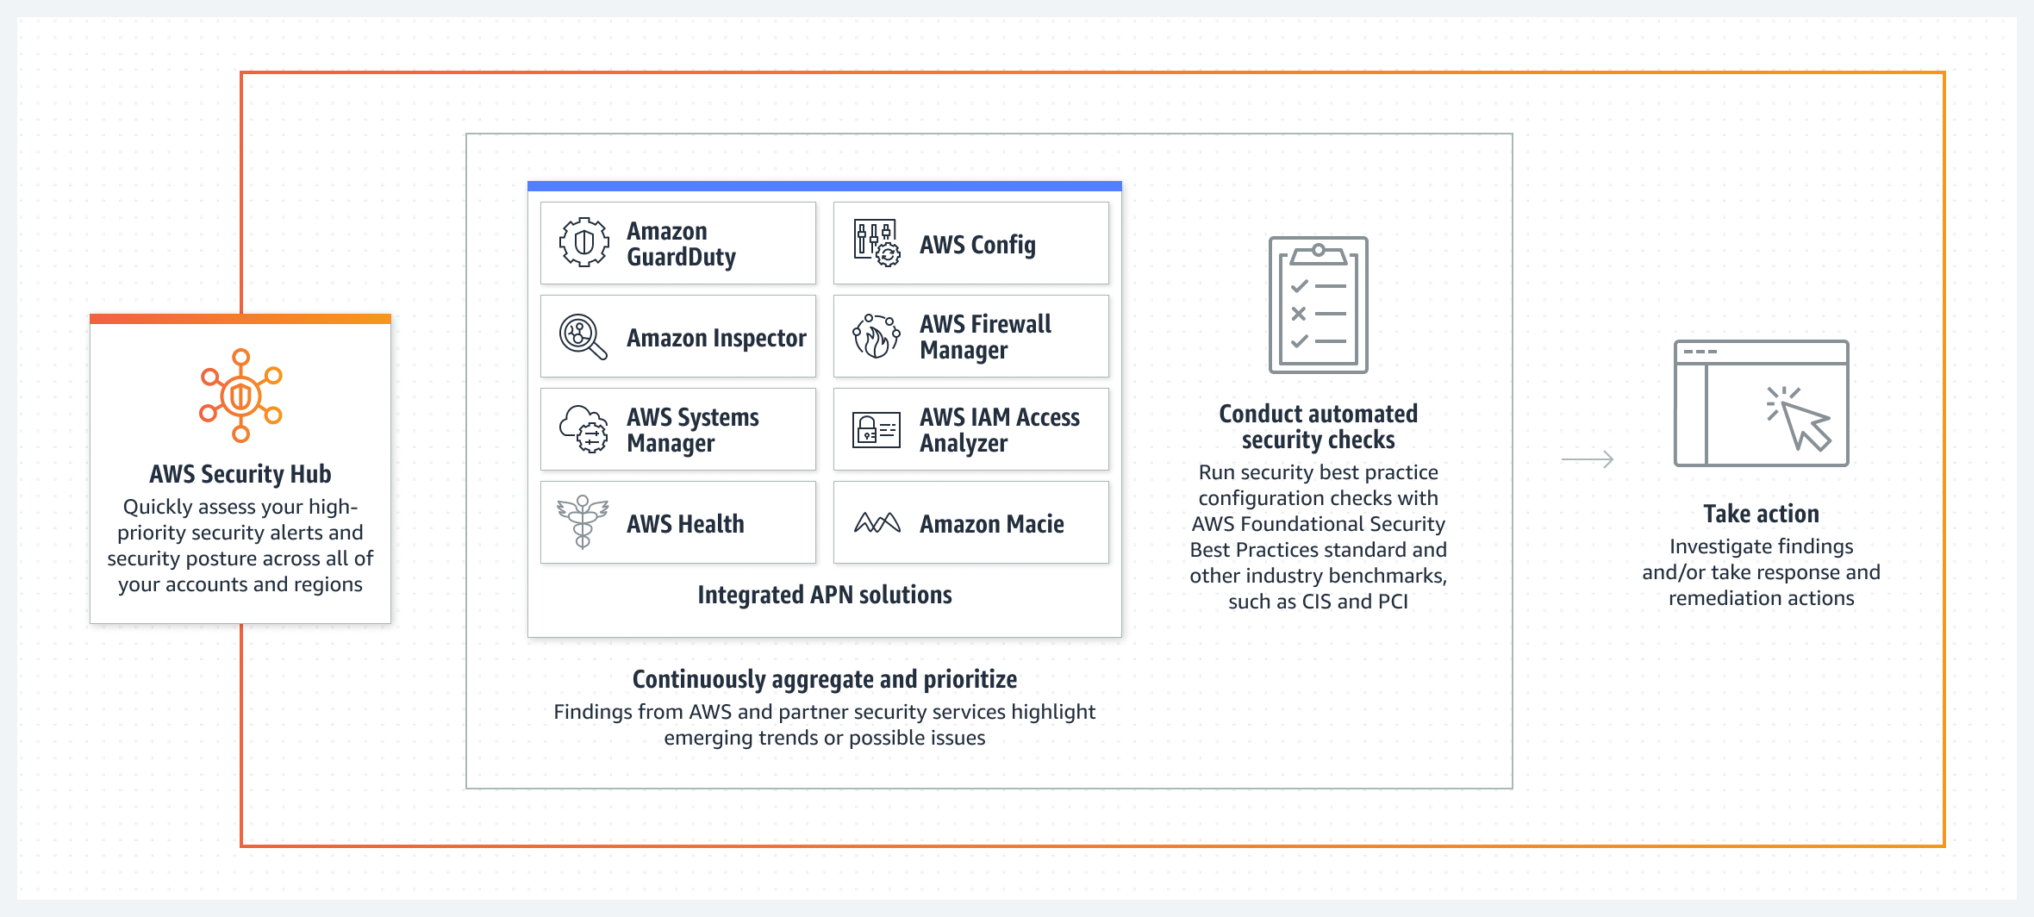
Advantages of Amazon Web Services Security Hub
CSPM (Cloud Security Posture Management)
CIS (Center for Internet Security)
PCI (Payment Card Industry)
DSS (Data Security Standard)
SOAR (Security Orchestration, Automation, & Response)
SIEM (Security Information and Event Management)
Notes:
In researching Amazon Web Services Security Hub, I have identified some major advantages over Microsoft Sentinel. For instance, AWS accumulates a range of powerful security tools that outmatch Microsoft Sentinel. Those tools include compliance scanners, vulnerability endpoint protection such as GuardDuty, and firewalls. The pros for AWS Security Hub is that it aggregates, organizes, and prioritizes security alerts or findings from other AWS services, all in one single pane. The downside to AWS Security Hub is that it lacks a certain level of self-sufficiency. AWS is not a multi-cloud solution. The fact of the matter is that AWS Security Hub is not a good global product.

Slide 4
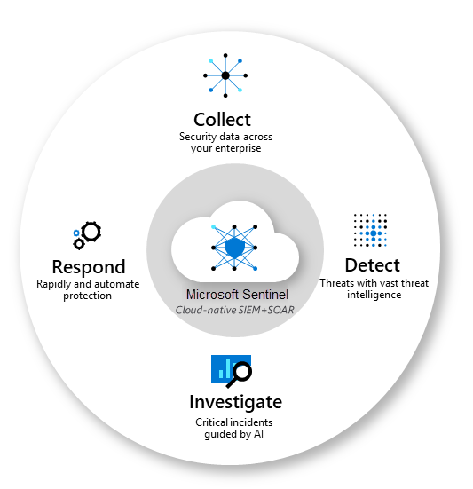
Advantages of Microsoft Sentinel​
SOAR (Security Orchestration, Automation, & Response)
Threat Intelligence
Automation
Response
Orchestration
SIEM (Security Information and Event Management)
Log management
Event Correlation
Incident Monitoring
Notes:
Microsoft Sentinel is a global multicloud product. Sentinel can connect to over 123 different data connectors. These connectors can pipe in streamlined SIEM threat and vulnerability management data to be used for Security Orchestration, Automation and Incident Response. Sentinel devastates the competition when it comes to automation, aggregation and correlation. The tools are exceptionally powerful. However, the area where Microsoft Lacks is in its native threat detection tools. AWS Security Hub tools suck as GuardDuty are more well equipped to handle threats.

Slide 5

Pairing Security Hub and Sentinel Together
“As the leading public cloud platforms, Azure and AWS each offer a broad and deep set of capabilities with global coverage. Yet many organizations choose to use both platforms together for greater choice and flexibility, as well as to spread their risk and dependencies with a multicloud approach” (Microsoft, n.d).
Notes:
The fact of the matter is, both solutions work best when paired together. Each service offers its own niece capabilities that when combined are just as good as top-tier private services used by large fortune 500 companies. I will paraphrase this quote by Microsoft’s team, they explain that even though Security Hub and Sentinel are the industry leading platforms, they need to be paired together to utilize a broad set of capabilities globally. This is because AWS Security Hub is best for detecting threats and Microsoft Sentinel is better at aggregating, correlating, and automating threat responses.

Slide 6
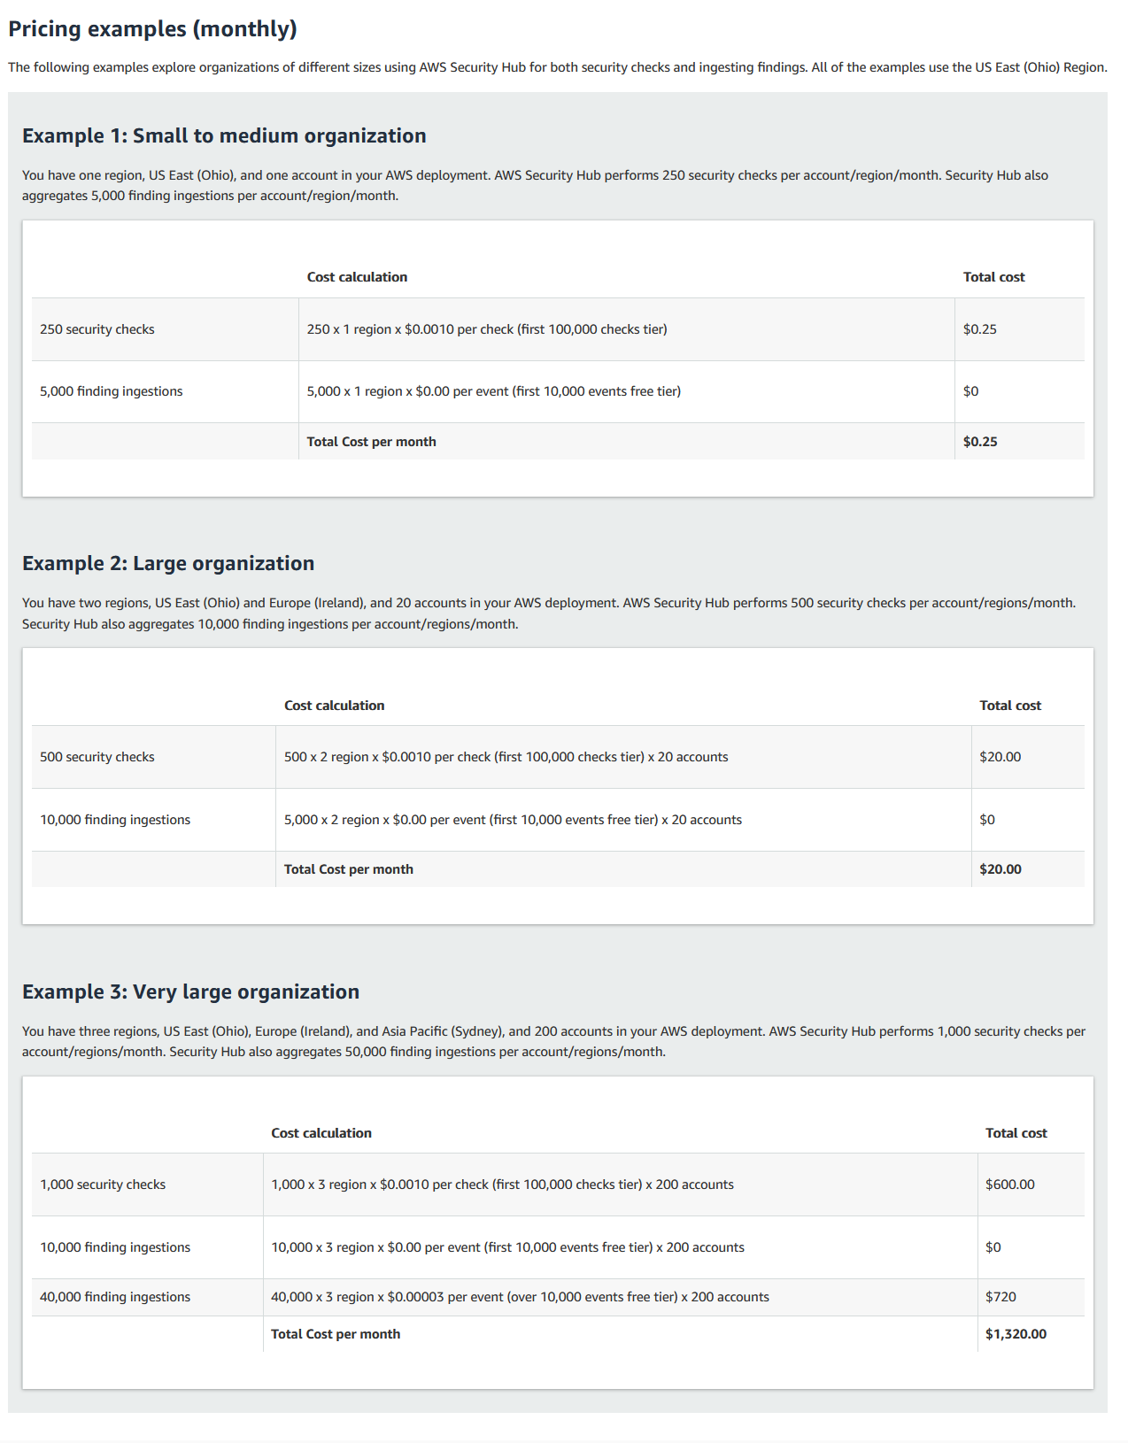
Cost of AWS Security Hub
Notes:
Now, we dive into the costs of the two products. The cost of AWS Security Hub is based on the amount of alerts generated. AWS breaks down the cost into three tiers, 1. small to medium organizations, 2. large organizations, and 3. very large organizations. Of course, when looking at the number of alerts generated for each tier you can tell that they have not spent a day in their life working as a SIEM/Cybersecurity Analyst. For the largest tier they only account for 40,000 findings per 200 accounts. A distributed denial of service attack can generate hundreds of thousands or even millions of alerts. For every million alerts that is generated from DDoS, it would be an extra $30 added on to the monthly bill. Although unfortunate, an extra $30. In looking deeper into the way AWS logs alerts, it only reports the amount of IP addresses being used in such an attack. So, in further investigation this does not seem to be a worry. Also, there are thresholds and limits that can be placed on alerts to keep the cost from exceeding a certain amount.

Slide 7
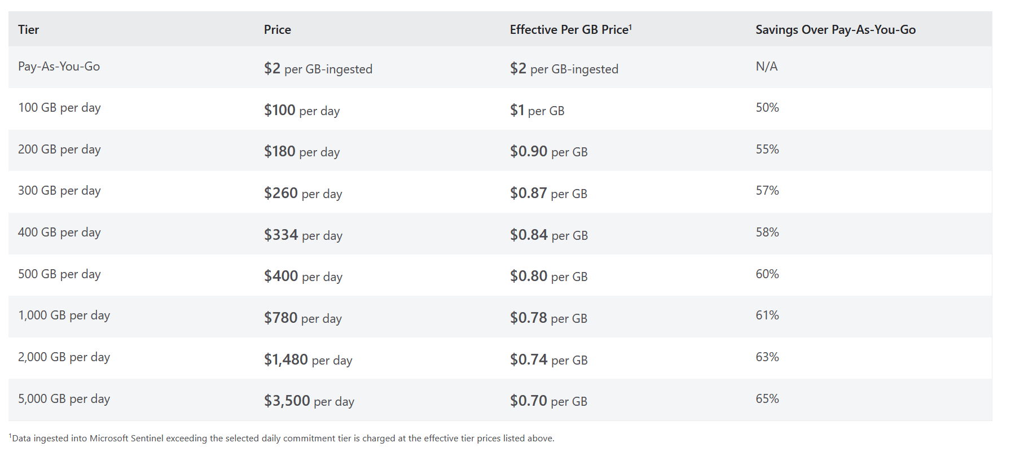
Cost of Microsoft Sentinel
Notes:
For the cost of Microsoft Sentinel, this is also based on the amount of alerts generated. They offer a pay-as-you-go plan which is very accommodating. If you have a fixed amount of data that you know you will use per daAt the bottom of the image, you can clearly see that Data ingested into Microsoft sentinel exceeding the selected limits will be charged at the effective price tier. Unfortunately, Microsoft Sentinel does not offer data caps/limitations that will prevent alerts from showing up from their data connectors. Therefore, all those limits must be configured directly on the data sources that you are monitoring. I do not see this becoming a problem unless you do not possess control over the data limits from a service provider.

Slide 8

Concerns
Cost of two services
Notes:
Unfortunately, I have a concern that I would like to address. If buying both services would cost more money, then why not just only buy one and not the other. This is a valid point, if you need better detection of threats then you should get AWS Security Hub. If you need better aggregation and correlation of threats, then you should get Microsoft Sentinel. The only problem with this idea is that if you have services running on both platforms, then it really does not make much of a difference because you would already be paying for their services. The ideal situation for using both services is that if an organization uses AWS for threat detection with GuardDuty or proprietary software on EC2 instances, but they need Microsoft Sentinel to process that data and give SOAR subjections. This would really be the only logical and cost-effective strategy.

Slide 9

Conclusion
Notes:
In conclusion, AWS Security Hub and Microsoft Sentinel are best paired together. AWS can detect threats better than its competition and Sentinel can categorize and aggregate those threats better than its competion.

Slide 10

Next Week’s Ideas​
Microsoft 365 defender
Notes:
For next weeks ideas I want to explore how I can connect Microsoft 365 defender to Microsoft Sentinels platform.

Slide 11

Thank You
Hope you enjoyed the presentation​
Notes:
Thank you, I hope you enjoyed my presentation.

Slide 12

References
Azure sentinel pricing: Microsoft Azure. Azure Sentinel Pricing | Microsoft Azure. (n.d.). Retrieved August 8, 2022, from https://azure.microsoft.com/en-us/pricing/details/microsoft-sentinel/
Carmi, N., (User), reviewer1650858, & Babuchandran, S. (n.d.). Which is better - azure sentinel or AWS Security Hub? Unbiased reviews from the tech community. Retrieved August 8, 2022, from https://www.peerspot.com/questions/which-is-better-azure-sentinel-or-aws-security-hub
Compare AWS security hub vs Microsoft Sentinel. Unbiased reviews from the tech community. (n.d.). Retrieved August 8, 2022, from https://www.peerspot.com/products/comparisons/aws-security-hub_vs_microsoft-sentinel
NeoSenninNeoSennin 16111 silver badge1515 bronze badges, & DatiseDatise 3. (1965, September 1). AWS autoscaling and ddos attacks. Stack Overflow. Retrieved August 8, 2022, from https://stackoverflow.com/questions/49676764/aws-autoscaling-and-ddos-attacks
U.S. Government Printing Office. (2014). The threat to Americans' personal information: A look into the security and reliability of the Health Exchange Data Hub: Hearing before the Subcommittee on Cybersecurity, Infrastructure Protection, and Security Technologies of the Committee on Homeland Security, House of Representatives, One Hundred Thirteenth Congress, First Session, September 11, 2013. Amazon. Retrieved August 8, 2022, from https://aws.amazon.com/security-hub/pricing/

